Slide 1
Software Quality Assurance
Dr. Seemab Latif
Lecture No. 12
13th Decemnber, 2010

Slide 2
Summary of Previous Lecture
“Unit Testing” is the first level of testing and the most important one.
Detecting and fixing bugs early on in the Software Lifecycle helps reduce costly fixes later on.
An Effective Unit Testing Process can and should be developed to increase the Software Reliability and credibility of the developer.
Many new developers take the unit testing tasks lightly and realize the importance of Unit Testing further down the road if they are still part of the project.

Slide 3
Integration Testing
What is integration testing?
system integration testing is a systematic technique for assembling a software system while conducting tests to uncover errors associated with interfacing.
The primary objective of integration testing is to assemble a reasonably stable system in a laboratory environment such that the integrated system can withstand the rigor of a full-blown system testing in the actual environment of the system.

Slide 4
Concept of Integration Testing
A system is a collection of modules interconnected in a certain way to accomplish a tangible objective.
A subsystem is an interim system that is not fully integrated with all the modules.
Modules are individually tested, which is commonly known as unit testing, by their respective programmers using white-box testing techniques.
At the unit testing level, the system exists in pieces under the control of the programmers. The next major task is to put the modules together to construct the complete system.

Slide 5
Concept of Integration Testing
Constructing a working system from the pieces is not a straightforward task, because of numerous interface errors.
Constructing a stable system from the components involves much testing. The path from tested components to constructing a deliverable system contains two major testing phases, namely, integration testing and system testing.

Slide 6
Why Integration Testing?
Different modules are generally created by groups of different developers. The developers may be working at different sites. In spite of our best effort in system design and documentation, misinterpretation, mistakes, and oversights do occur in reality. Interface errors between modules created by different programmers and even by the same programmers are uncontrollable.

Slide 7
Why Integration Testing?
Unit testing of individual modules is carried out in a controlled environment by using test drivers and stubs. Stubs are dummy modules which merely return predefined values. If a module under unit test invokes several other modules, the effectiveness of unit testing is constrained by the programmer’s ability to effectively test all the paths. Therefore, with the inherent limitations of unit testing, it is difficult to predict the behaviour of a module in its actual environment after the unit testing is performed.
Some modules are more error prone than other modules, because of their inherent complexity. It is essential to identify the ones causing most failures.

Slide 8
Integration Testing Objective
The objective of system integration is to build a “working” version of the system by
putting the modules together in an incremental manner and
Ensuring that the additional modules work as expected without disturbing the functionalities of the modules already put together.

Slide 9
When Integration Testing is Complete?
Integration testing is said to be complete when the system is fully integrated together, all the test cases have been executed, all the severe and moderate defects found have been fixed, and the system is retested.

Slide 10
Granularity of System Integration Testing
System integration testing is performed at different levels of granularity. Integration testing includes both white- and black-box testing approaches.
Black-box testing ignores the internal mechanisms of a system and focuses solely on the outputs generated in response to selected inputs and execution conditions. The code is considered to be a big black box by the tester who cannot examine the internal details of the system. The tester knows the input to the black box and observes the expected outcome of the execution.
White-box testing uses information about the structure of the system to test its correctness. It takes into account the internal mechanisms of the system and the modules.

Slide 11
Granularity of System Integration Testing
Integration testing is performed at three levels of granularity:
Intra-system testing
Inter-system testing
Pair-wise testing.

Slide 12
1. Intra-system Testing
This form of testing constitutes low-level integration testing with the objective of combining the modules together to build a cohesive system.
The process of combining modules can progress in an incremental manner similar to constructing and testing successive builds.
For example, in a client–server-based system both the client and the server are distinct entities running at different locations. Before the interactions of clients with a server are tested, it is essential to individually construct the client and the server systems from their respective sets of modules in an incremental fashion. The low-level design document, which details the specification of the modules within the architecture, is the source of test cases.

Slide 13
2. Inter-system Testing
Intersystem testing is a high-level testing phase which requires interfacing independently tested systems. In this phase, all the systems are connected together, and testing is conducted from end to end. The term end to end is used in communication protocol systems, and end-to-end testing means initiating a test between two access terminals interconnected by a network.
The purpose in this case is to ensure that the interaction between the systems work together, but not to conduct a comprehensive test. Only one feature is tested at a time and on a limited basis. Later, at the time of system testing, a comprehensive test is conducted based on the requirements, and this includes functional, interoperability, stress, performance, and so on.
Integrating a client–server system, after integrating the client module and the server module separately, is an example of intersystem testing.
Integrating a call control system and a billing system in a telephone network is another example of intersystem testing. The test cases are derived from the high-level design document, which details the overall system architecture.

Slide 14
3. Pairwise Testing
There can be many intermediate levels of system integration testing between the above two extreme levels, namely intrasystem testing and intersystem testing. Pairwise testing is a kind of intermediate level of integration testing.
In pairwise integration, only two interconnected systems in an overall system are tested at a time. The purpose of pairwise testing is to ensure that two systems under consideration can function together, assuming that the other systems within the overall environment behave as expected.
The whole network infrastructure needs to be in place to support the test of interactions of the two systems, but the rest of the systems are not subject to tests. The network test infrastructure must be simple and stable during pairwise testing.
While pairwise testing may sound simple, several issues can complicate the testing process. The biggest issue is unintended side effects. For example, in testing communication between a network element (radio node) and the element management systems, if another device (radio node controller) within the 1xEV-DO wireless data network fails during the test, it may trigger a high volume of traps to the element management systems. Untangling this high volume of traps may be difficult.

Slide 15
System Integration Techniques
Integration testing need not wait until all the modules of a system are coded and unit tested. Instead, it can begin as soon as the relevant modules are available.
Some common approaches to performing system integration are as follows:
Incremental
Top down
Bottom up
Sandwich
Big bang

Slide 16
Incremental
In this approach, integration testing is conducted in an incremental manner as a series of test cycles.
In each test cycle, a few more modules are integrated with an existing and tested build to generate a larger build.
The idea is to complete one cycle of testing, let the developers fix all the errors found, and continue the next cycle of testing.
The complete system is built incrementally, cycle by cycle, until the whole system is operational and ready for system-level testing.

Slide 17
Incremental
The system is built as a succession of layers, beginning with some core modules.
In each cycle, a new layer is added to the core and tested to form a new core.
The new core is intended to be self-contained and stable. Here, “self-contained” means containing all the necessary code to support a set of functions, and “stable” means that the subsystem (i.e., the new, partial system) can stay up for 24 hours without any anomalies.

Slide 18
Incremental
The number of system integration test cycles and the total integration time are determined by the following parameters:
Number of modules in the system
Relative complexity of the modules (cyclomatic complexity)
Relative complexity of the interfaces between the modules
Number of modules needed to be clustered together in each test cycle
Whether the modules to be integrated have been adequately tested before
Turnaround time for each test–debug–fix cycle

Slide 19
Top Down
Systems with hierarchical structures easily lend themselves to top-down and bottom-up approaches to integration.
In a hierarchical system, there is a first, top-level module which is decomposed into a few second-level modules. Some of the second-level modules may be further decomposed into third-level modules, and so on.
Some or all the modules at any level may be terminal modules, where a terminal module is one that is no more decomposed.
An internal module, also known as a non-terminal module, performs some computations, invokes its subordinate modules, and returns control and results to its caller.

Slide 20
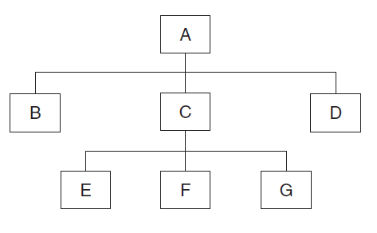
Top Down
In top-down and bottom-up approaches, a design document giving the module hierarchy is used as a reference for integrating modules.
For example, in hierarchy given blow there are three levels and 7 modules.

Slide 21
Top Down
The limitations of the top-down approach are as follows:
Until a certain set of modules has been integrated, it may not be possible to observe meaningful system functions because of an absence of lower level modules and the presence of stubs.
Test case selection and stub design become increasingly difficult when stubs lie far away from the top-level module. This is because stubs support limited behaviour, and any test run at the top level must be constrained to exercise the limited behaviour of lower level stubs.

Slide 22
Bottom Up
In the bottom-up approach, system integration begins with the integration of lowest level modules.
A module is said to be at the lowest level if it does not invoke another module. It is assumed that all the modules have been individually tested before.
To integrate a set of lower level modules in this approach, we need to construct a test driver module that invokes the modules to be integrated.
Once the integration of a desired group of lower level modules is found to be satisfactory, the driver is replaced with the actual module and one more test driver is used to integrate more modules with the set of modules already integrated.
The process of bottom-up integration continues until all the modules have been integrated.

Slide 23
Bottom Up
The disadvantages of the bottom-up approach are as follows:
Test engineers cannot observe system-level functions from a partly integrated system. In fact, they cannot observe system-level functions until the top-level test driver is in place.
Generally, major design decisions are embodied in top-level modules, whereas most of the low-level modules largely perform commonly known input–output functions. Discovery of major flaws in system design may not be possible until the top-level modules have been integrated.

Slide 24
Top Down and Bottom Up Comparison
Validation of Major Design Decisions:
The top-level modules contain major design decisions. Faults in design decisions are detected early if integration is done in a top-down manner. In the bottom-up approach, those faults are detected toward the end of the integration process.
Observation of System-Level Functions:
One applies test inputs to the top-level module, which is similar to performing system-level tests in a very limited way in the top-down approach. This gives an opportunity to the SIT personnel and the development team to observe system-level functions early in the integration process. However, similar observations can be done in the bottom-up approach only at the end of system integration.

Slide 25
Top Down and Bottom Up Comparison
Difficulty in Designing Test Cases:
In the top-down approach, as more and more modules are integrated and stubs lie farther away from the top-level module, it becomes increasingly difficult to design stub behaviour and test input. This is because stubs return predetermined values, and a test engineer must compute those values for a given test input at the top level. However, in the bottom-up approach, one designs the behaviour of a test driver by simplifying the behaviour of the actual module.
Reusability of Test Cases:
In the top-down approach, test cases designed to test the interface of a newly integrated module is reused in performing regression tests in the following iteration. Those test cases are reused as system-level test cases. However, in the bottom-up approach, all the test cases incorporated into test drivers, except for the top-level test driver, cannot be reused. The top-down approach saves resources in the form of time and money.

Slide 26
Sandwich
In the sandwich approach, a system is integrated by using a mix of the top-down and bottom-up approaches.
A hierarchical system is viewed as consisting of three layers. The bottom layer contains all the modules that are often invoked. The bottom-up approach is applied to integrate the modules in the bottom layer.
The top layer contains modules implementing major design decisions. These modules are integrated by using the top-down approach. The rest of the modules are put in the middle layer.
We have the advantages of the top-down approach where writing stubs for the low-level module is not required. As a special case, the middle layer may not exist, in which case a module falls either in the top layer or in the bottom layer. On the other hand, if the middle layer exists, then this layer can be integrated by using the big-bang approach after the top and the bottom layers have been integrated.

Slide 27
Big Bang
In the big-bang approach, first all the modules are individually tested. Next, all those modules are put together to construct the entire system which is tested as a whole.
Sometimes developers use the big-bang approach to integrate small systems. However, for large systems, this approach is not recommended for the following reasons:
In a system with a large number of modules, there may be many interface defects. It is difficult to determine whether or not the cause of a failure is due to interface errors in a large and complex system.
In large systems, the presence of a large number of interface errors is not an unlikely scenario in software development. Thus, it is not cost effective to be optimistic by putting the modules together and hoping it will work.

Slide 28
Integration Techniques Evaluation
Solheim and Rowland measured the relative efficacy of top-down, bottom-up, sandwich, and big-bang integration strategies for software systems.
The empirical study indicated that top-down integration strategies are most effective in terms of defect correction.
Top-down and big-bang strategies produced the most reliable systems.
Bottom-up strategies are generally least effective at correcting defects and produce the least reliable systems.
Systems integrated by the sandwich strategy are moderately reliable in comparison.

Slide 29
Test Plan for System Integration
System integration requires a controlled execution environment, much communication between the developers and the test engineers, careful decision making along the way, and much time, on the order of months, in addition to the fundamental tasks of test design and test execution.
Integrating a large system is a challenging task, which is handled with much planning in the form of developing a SIT plan.

Slide 30
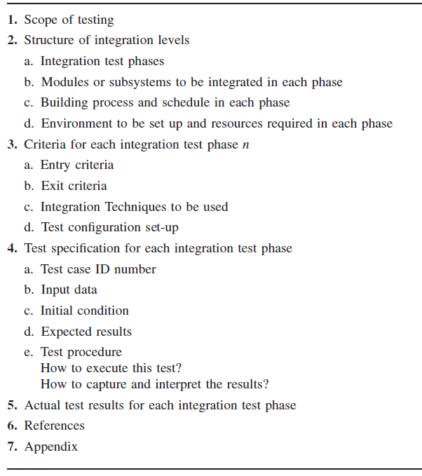
Framework for SIT Plan
An important decision to be made for integration testing is establishing the start and stop dates of each phase of integration testing. The start date and stop date for a phase are specified in terms of entry criteria and exit criteria, respectively. These criteria are described in the third section of the plan.
In the scope of testing section, one summarizes the system architecture. Specifically, the focus is on the functional, internal, and performance characteristics to be tested. System integration methods and assumptions are included in this section.
The first subsection explains the division of integration testing into different phases, such as functional, end-to-end, and endurance phases.
The test specification section describes the test procedure to be followed in each integration phase. The detailed test cases, including the input and expected outcome for each case, are documented in the test specification section.
The second subsection describes the modules to be integrated in each of the integration phases.
The third subsection describes the build process to be followed: daily build, weekly build, biweekly build, or a combination. A schedule for system integration is given in this section. Specifically, one identifies the start and end dates for each phase of testing.
In the fourth subsection, the test
environment and the resources required are described for each integration phase.
The history of actual test results, problems, or peculiarities is recorded in the fifth section of the SIT plan.
Finally, references and an appendix, if any, are included in the test plan.

Slide 31
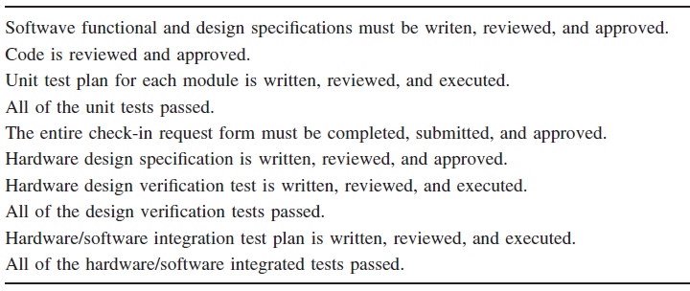
Framework for Entry Criteria to Start System Integration

Slide 32
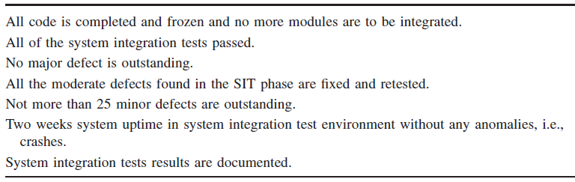
Framework for System Integration Exit Criteria

Slide 33
System Integration Testing Phases
System integration testing is performed in phases of increasing complexity for better efficiency and effectiveness.
In the first phase interface integrity and functional validity within a system are tested.
In the second phase end-to-end and pairwise tests are conducted.
Finally, in the third phase, stress and endurance tests are performed.
Each of the system integration phases identified in the SIT plan outline a broad functionality category within the software structure.

Slide 34
Interface Integrity
Interface: An interface between two modules allows one module to access the service provided by the other. It implements a mechanism for passing control and data between modules.
Internal and external interfaces are tested as each module is integrated into the structure. When two modules are integrated, the communication between them is called internal, whereas when they communicate with the outside environment, it is called external.
An important part of interface testing is to map an incoming message format to the expected message format of the receiving module and ensure that the two match. Tests are designed for each message passing through the interface between two modules.

Slide 35
Functional and End-to-End Validity
Functional Validity: Tests are designed to uncover functional errors in each module after it is integrated with the system. Errors associated with local or global data structures are uncovered with such tests. Selected unit tests that were designed for each module are re-executed during system integration by replacing the stubs with their actual modules.
End-to-End Validity: Tests are performed to ensure that a completely integrated system works together from end to end. Interim checkpoints on an end-to-end flow provide a better understanding of internal mechanisms. This helps in locating the sources of failures.

Slide 36
Pairwise and Interface Stress
Pairwise Validity: Tests are performed to ensure that any two systems work properly when connected together by a network. The difference between pairwise tests and end-to-end tests lies in the emphasis and type of test cases. For example, a toll-free call to an 800 number is an end-to-end test of a telephone system, whereas a connectivity test between a handset and local private branch exchange is a pairwise test.
Interface Stress: Stress is applied at the module level during the integration of the modules to ensure that the interfaces can sustain the load. On the other hand, full-scale system stress testing is performed at the time of system-level testing.

Slide 37
System Endurance
A completely integrated system is expected to stay up continuously for weeks without any crashes. In the case of communication protocol systems, formal rules govern that two systems communicate with each other via an interface, that is, a communication channel. The idea here is to verify that the format and the message communication across the interface of the modules works for an extended period.

Slide 38
Off-the-Shelf Component Integration
Instead of developing a software component from scratch, organizations occasionally purchase off-the-shelf (OTS) components form third-party vendors and integrate them with their own components.
In this process, organizations create less expensive software systems.
A major issue that can arise while integrating different components is mismatches among code pieces developed by different parties usually unaware of each other.

Slide 39
Off-the-Shelf Component Integration
Vigder and Dean have presented elements of an architecture for integration and have defined rules that facilitate integration of components.
They have identified a useful set of supporting components for integrating the actual and serving components. The supporting components are:
Wrappers
Glue
Tailoring.

Slide 40
Wrapper and Glue
A wrapper is a piece of code that one builds to isolate the underlying components from other components of the system. Here isolate means putting restrictions around the underlying component to limit its capabilities.
A glue component provides the functionality to combine different components.

Slide 41
Tailoring
Component tailoring refers to the ability to enhance the functionality of a component. Tailoring is done by adding some elements to a component to enrich it with a functionality not provided by the vendor.
Tailoring does not involve modifying the source code of the component.

Slide 42
Off-the-Shelf Component Testing
Organizations perform two types of testing on an OTS component before purchasing:
Acceptance testing of the OTS component
Integration of the component with other components developed in-house or purchased from a third party.
The most common cause of problems in the integration phase is inadequate acceptance testing of the OTS component.

Slide 43
Summary
One creates a “working version of the system” by putting the modules together in an incremental manner while performing tests to uncover different types of errors associated with interfacing.
Next, we explored various levels of granularities in system integration testing: intrasystem testing, intersystem testing, and pairwise testing.
We then examined five types of commonly used system integration techniques: topdown, bottomup, sandwich, bigbang, and incremental. We compared those techniques in detail. The incremental technique is widely used in the industry.
We provided a framework of an integration test plan. The following categories of tests, which are included in an integration test plan, were discussed in detail: interface integrity tests, functional validity tests, end-to-end validity tests, pairwise validity tests, interface stress tests, and endurance tests.
Finally, we described the integration of OTS components with other components. An organization, instead of developing a software component from scratch, may decide to purchase a COTS software from a third-party source and integrate it with its own software system.

Slide 44
Assignment 2
Due Date: 23rd Dec, 2010
No extension in deadline
Task:
For your current Term project, develop an integration test plan.

